Slide 1
OTFS based on OFDM System
Fadi Hantouli
04/17/2023
Meeting-20230415_153116-Meeting Recording.mp4

Slide 2
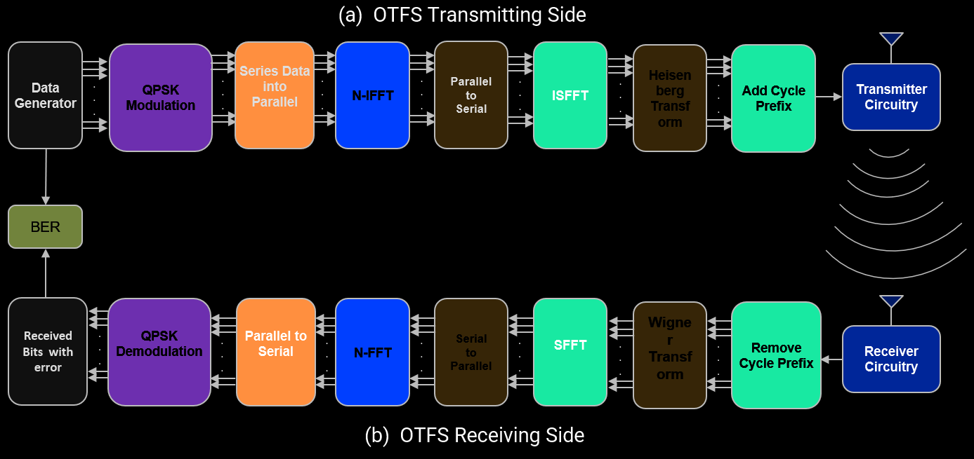
Introduction
Purpose
To explore the concept of Orthogonal Time Frequency Space (OTFS) for use in establishing a transmitter and receiver.
To allow the researcher to investigate and evaluate the performance of OTFS systems under different conditions and understand their capabilities.
Objectives
To study the Delay and Doppler effects on an OTFS system.
To identify the optimal parameters for an OTFS system, measure the effective range of an OTFS system, analyze the impact of delay and Doppler effects on an OTFS system.
Motivation
To provide insight into the potential of OTFS systems in the development of communication systems. The findings of this project will be invaluable for future research in the field of wireless communication.

Slide 3
Literature review
Orthogonal Time Frequency Space (OTFS) is a relatively new form of Orthogonal Frequency Division Multiplexing (OFDM) that has recently been used in wireless communication systems. OTFS promises improved performance compared to traditional OFDM techniques due to its unique ability to mitigate the effect of time-varying multipath and Doppler, thus reducing the impact of interference. OTFS is a promising technology for next-generation wireless communication systems as it offers improved spectral efficiency, data rate, and packet error rate [1][2][3][4][5].
In recent years, several research studies have explored the performance of OTFS systems in several different scenarios. These studies have generally focused on analyzing the effect of Delay and Doppler on OTFS systems and the influence of various parameters on the performance of the system.
In one such study, the performance of OTFS systems was compared to that of conventional OFDM systems in a multipath fading environment. The results of the study showed that OTFS was able to effectively mitigate the effect of multipath fading and provide improved data rate, packet error rate, and spectral efficiency [6][7][8][9].
In addition to performance analysis, several studies have also investigated the design of OTFS systems. These studies have explored the impact of different signal processing techniques such as modulation, coding, and transmit diversity on the performance of OTFS systems [10][11][12][13][14][15].
One study, in particular, investigated the effect of transmit diversity on the performance of OTFS systems in a frequency-selective fading channel. The results of this study showed that transmit diversity can be effective in improving the performance of OTFS systems. Overall, the literature suggests that OTFS systems can offer improved performance compared to traditional OFDM techniques in terms of data rate, packet error rate, and spectral efficiency [16][17][18].
In addition, studies have demonstrated that the design of OTFS systems can be optimized by incorporating techniques such as transmit diversity and signal processing algorithms. The findings of these studies are invaluable for future research in the field of wireless communication and provide insight into the potential of OTFS systems in the development of communication systems [19][20].

Slide 4
Methodology
The methodology used for this project involves the theoretical methods: Mathematical Modeling, and Simulations. The mathematical modeling involves using mathematical equations to describe the behavior of an OTFS system in terms of the parameters used, such as the number of sub-carriers, the modulation scheme, the coding scheme, etc. The simulation involves designing the model of the system and running the mathematical model in order to analyze the system's performance using Matlab. Experiments are then conducted to compare the system's performance to existing OFDM systems. Additionally, the system's performance is evaluated using metrics such as data rate, packet error rate, and spectral efficiency. Finally, the assessment results are used to identify areas of improvement and strategies to optimize the system's performance.
The theoretical methods involve the use of Matlab Live Script to design the Transmiter ( generate dummy data , QPSK Modulation, Delay Doppler Modulation), Channel, and Receiver (Demodoulation of QPSK and Delay Doppler) to test the system’s performance in softwere environment. The data generated from the Dummy Data Generator will be used to assess the system’s performance, as well as identify any potential issues or areas of improvement. The analysis of the results will involve the comparison of the performance of the OTFS system to existing OFDM systems. This will allow for the identification of any strengths and weaknesses of the OTFS system, as well as any areas of improvement.

Slide 5
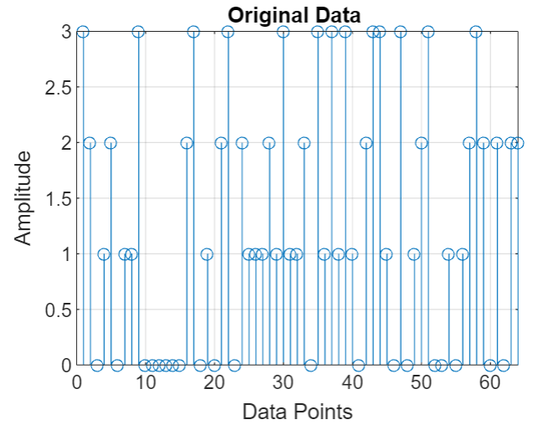
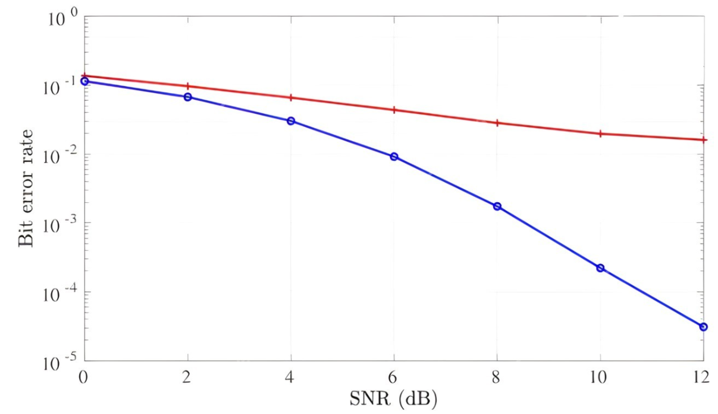
Results and analysis
OFDM
OTFS
We will evaluate the fundamental of OFDM and OTFS modulation scheme for parameters estimation. The evaluations are performed in Bet error Rate vs SNR:
  OTFS provide high date rate, better flexibility and reliability as compared to OFDM.
  OTFS provides high frequency dispersion.
  OTFS have better performance as compared to OFDM over the channel with high Doppler spread, which is due to the fact that OTFS performs better in time-varying channels.
  OTFS also provides better flexibility and reliability by introducing time and frequency diversity, which are not available in OFDM.
  OTFS can better handle frequency-selective fading as compared to OFDM, as it can spread the data in both time and frequency domains.

Slide 6
Discussion
The evaluation of these two modulation schemes for parameter estimation clearly demonstrates that OTFS provides better performance than OFDM. OTFS provides better flexibility and reliability by introducing time and frequency diversity, which are not available in OFDM. OTFS can better handle frequency-selective fading as compared to OFDM, as it can spread the data in both time and frequency domains. This makes OTFS a more attractive technology for modern communication systems, especially in the context of wireless applications.
The results of this evaluation provide a valuable insight into the performance of OTFS and can provide guidance for the design of communication systems that use OTFS. These results are important for researchers in the field of communication technologies and signal processing as they provide insight into the performance of OTFS over OFDM, which could help in designing more efficient communication systems. Additionally, these results provide valuable information for industry professionals who are looking to use either of these technologies in their applications.

Slide 7
Conclusion
Challenges
One of the main challenges faced in this project was the lack of knowledge and experience with mathematical modeling and simulations. This was overcome by researching the various methods and techniques used in mathematical modeling and simulations and applying them to the OTFS system. Additionally, I had to develop a comprehensive understanding of the system parameters and how they affect the system's performance. This was achieved through extensive research and experimentation.
Limitation
  The increased receiver complexity is a challenge that needs to be addressed. Researchers are focusing on algorithms to reduce receiver complexity, as well as other optimizations for OTFS. With further research, OTFS could become a viable solution for next-generation wireless networks.
Future Applications
  OTFS modulation has many applications in next generation wireless networks. It is especially beneficial for Vehicle-to-Vehicle communications, millimeter-wave communications, non-terrestrial communications, and underwater acoustic communications. OTFS is advantageous because it can handle high mobility channels, high Doppler spread, phase noise, and delay spread. It is also low in complexity and has a low BET compared to other standards. This makes it ideal for space-borne and airborne vehicles, as well as for overcoming the limited computing capability and on-board power supply of such platforms.
The main message
  It is a promising two-dimensional modulation technique that can offer various benefits over one-dimensional modulation techniques. These benefits include a lower bit error rate, better adaptability to different channel conditions, and the potential to reduce latency in wireless communication

Slide 8
Acknowledgments
I would like to thank the following Professors for their invaluable contribution to the success of our OTFS project:
Dr. Billy Kihei bhbhhbh
Dr. Sumit Chakravarty
We are deeply grateful for your support and commitment to this project. Your generous contributions have made this project a reality.
Thank you All!

Slide 9
References
[1] L. Gaudio, G. Colavolpe and G. Caire, "OTFS vs. OFDM in the Presence of Sparsity: A Fair Comparison," in IEEE Transactions on Wireless Communications, vol. 21, no. 6, pp. 4410-4423, June 2022, doi: 10.1109/TWC.2021.3129975.
[2] M. Joshi, G. Punjabi, B. Sainath and A. Chintanpalli, "Comparative Performance Investigation of MIMO-OTFS and MIMO-OFDM using Deep Neural Network Modeling," 2021 IEEE 18th India Council International Conference (INDICON), Guwahati, India, 2021, pp. 1-6, doi: 10.1109/INDICON52576.2021.9691490.
[3] S. Sruti, K. S. Teja and K. Giridhar, "Performance Comparison of OTFS and MC-CDMA with Channel Estimation and Power Back-Off," MILCOM 2022 - 2022 IEEE Military Communications Conference (MILCOM), Rockville, MD, USA, 2022, pp. 693-698, doi: 10.1109/MILCOM55135.2022.10017617.
[4] V. Rangamgari, S. Tiwari, S. S. Das and S. C. Mondal, "OTFS: Interleaved OFDM with Block CP," 2020 National Conference on Communications (NCC), Kharagpur, India, 2020, pp. 1-6, doi: 10.1109/NCC48643.2020.9056003.
[5] A. Gunturu, A. R. Godala, A. K. Sahoo and A. K. R. Chavva, "Performance Analysis of OTFS Waveform for 5G NR mmWave Communication System," 2021 IEEE Wireless Communications and Networking Conference (WCNC), Nanjing, China, 2021, pp. 1-6, doi: 10.1109/WCNC49053.2021.9417346.
[6] H. Liu, Y. Liu, M. Yang and Q. Zhang, "On the Characterizations of OTFS Modulation Over Multipath Rapid Fading Channel," in IEEE Transactions on Wireless Communications, vol. 22, no. 3, pp. 2008-2021, March 2023, doi: 10.1109/TWC.2022.3208161.
[7] A. Thomas, K. Deka, S. Sharma and N. Rajamohan, "IRS-Assisted OTFS System: Design and Analysis," in IEEE Transactions on Vehicular Technology, vol. 72, no. 3, pp. 3345-3358, March 2023, doi: 10.1109/TVT.2022.3217140.
[8] F. Qin, Y. Ji, X. Sun and Z. Wei, "Research on Frequency Domain Channel Estimation Method Based on OTFS System," 2022 IEEE 6th Information Technology and Mechatronics Engineering Conference (ITOEC), Chongqing, China, 2022, pp. 973-978, doi: 10.1109/ITOEC53115.2022.9734656.
[9] S. He, Q. Zhang and J. Qin, "Pilot Pattern Design for Two-Dimensional OFDM Modulations in Time-Varying Frequency-Selective Fading Channels," in IEEE Transactions on Wireless Communications, vol. 21, no. 2, pp. 1335-1346, Feb. 2022, doi: 10.1109/TWC.2021.3103734.
[10] D. A. Rodríguez, "Symplectic Tensor Signal Algebraic Framework for Delay-Doppler Processing in OTFS Networks," 2021 IEEE Latin-American Conference on Communications (LATINCOM), Santo Domingo, Dominican Republic, 2021, pp. 1-6, doi: 10.1109/LATINCOM53176.2021.9647808.
[11] Z. Yuan, F. Liu, W. Yuan, Q. Guo, Z. Wang and J. Yuan, "Iterative Detection for Orthogonal Time Frequency Space Modulation With Unitary Approximate Message Passing," in IEEE Transactions on Wireless Communications, vol. 21, no. 2, pp. 714-725, Feb. 2022, doi: 10.1109/TWC.2021.3097173.
[12] Y. Wang and Y. Zhang, "Precoding Design for Uplink MU-MIMO-OTFS with Statistical Information of Doppler Shift," 2022 IEEE 22nd International Conference on Communication Technology (ICCT), Nanjing, China, 2022, pp. 157-161, doi: 10.1109/ICCT56141.2022.10072599.
[13] T. Thaj, E. Viterbo and Y. Hong, "Orthogonal Time Sequency Multiplexing Modulation: Analysis and Low-Complexity Receiver Design," in IEEE Transactions on Wireless Communications, vol. 20, no. 12, pp. 7842-7855, Dec. 2021, doi: 10.1109/TWC.2021.3088479.
[14] H. Lin and J. Yuan, "Orthogonal Delay-Doppler Division Multiplexing Modulation," in IEEE Transactions on Wireless Communications, vol. 21, no. 12, pp. 11024-11037, Dec. 2022, doi: 10.1109/TWC.2022.3188776.
[15] Z. Gong, S. Liu and Y. Huang, "Doppler Diversity Reception for OTFS Modulation," 2022 IEEE 95th Vehicular Technology Conference: (VTC2022-Spring), Helsinki, Finland, 2022, pp. 1-5, doi: 10.1109/VTC2022-Spring54318.2022.9860675.
[16] D. Wang, B. Sun, F. Wang, X. Li, P. Yuan and D. Jiang, "Transmit diversity scheme design for rectangular pulse shaping based OTFS," in China Communications, vol. 19, no. 3, pp. 116-128, March 2022, doi: 10.23919/JCC.2022.03.008.
[17] V. S. Bhat and A. Chockalingam, "Performance Analysis of OTFS Modulation with Transmit Antenna Selection," 2021 IEEE 93rd Vehicular Technology Conference (VTC2021-Spring), Helsinki, Finland, 2021, pp. 1-6, doi: 10.1109/VTC2021-Spring51267.2021.9448900.
[18] D. Wang, B. Sun, F. Wang, X. Li, P. Yuan and D. Jiang, "Transmit diversity scheme design for rectangular pulse shaping based OTFS," in China Communications, vol. 19, no. 3, pp. 116-128, March 2022, doi: 10.23919/JCC.2022.03.008.
[19] V. S. Bhat and A. Chockalingam, "Performance Analysis of OTFS Modulation with Transmit Antenna Selection," 2021 IEEE 93rd Vehicular Technology Conference (VTC2021-Spring), Helsinki, Finland, 2021, pp. 1-6, doi: 10.1109/VTC2021-Spring51267.2021.9448900.
[20] Z. Ding, R. Schober, P. Fan and H. Vincent Poor, "OTFS-NOMA: An Efficient Approach for Exploiting Heterogenous User Mobility Profiles," in IEEE Transactions on Communications, vol. 67, no. 11, pp. 7950-7965, Nov. 2019, doi: 10.1109/TCOMM.2019.2932934.

Slide 10
Additional materials
https://github.com/bb16177/OTFS-Simulation
https://github.com/edenhu1111/OTFS-sensing
https://www.mathworks.com/matlabcentral/fileexchange/54073-ofdm-performance-over-rayleigh-fading-channel-theory-and-simulation?s_tid=srchtitle
https://www.mathworks.com/matlabcentral/fileexchange/29816-ofdm-subcarriers?s_tid=srchtitle

